Slide 1

GYM-GENIE
GYM Management System
Rohit Phulari=233061
Malhar Patil=233178

Slide 2
Gyms are the essential part of our lives, providing best exercise and body building facilities to our society
At the management end there are some necessary steps to maintain the records of every individual including trainer, gym members, and admin but maintaining the records on paper is very difficult
So it is necessary to have a computerized system that manages all these functionality. Thus working on the management system for gym industry is the basis of our project.
Problem Statement

Slide 3

Register user by itself
Book a membership
See workout plans + diet plans
AUD (add,update,delete) diet plan + workout plan by trainer
AUD (add,update,delete) membership plan by admin
AUD (add,update,delete) trainers access by admin
See members list By Admin
Project Objectives

Slide 4
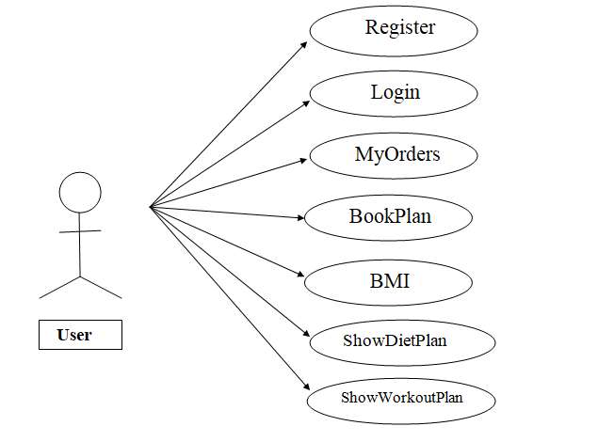
Role Of Services
1.0-User

Slide 5
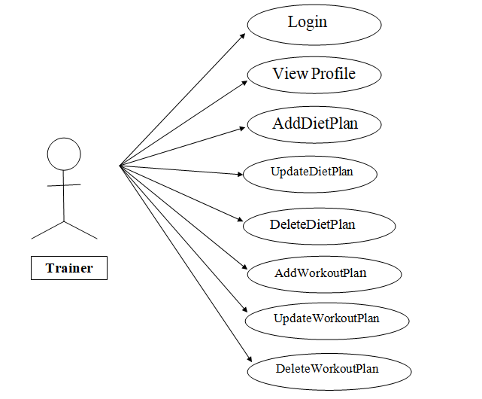
Role Of Services
2.0-Trainer

Slide 6
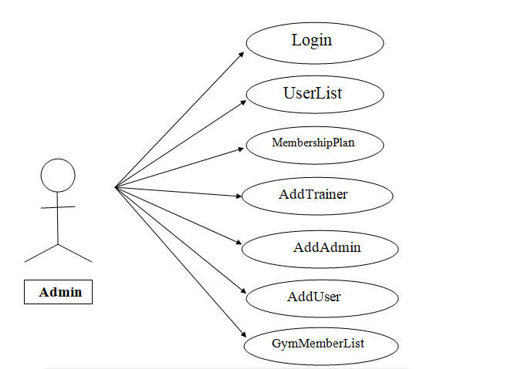
Role Of Services
2.0-Admin

Slide 7
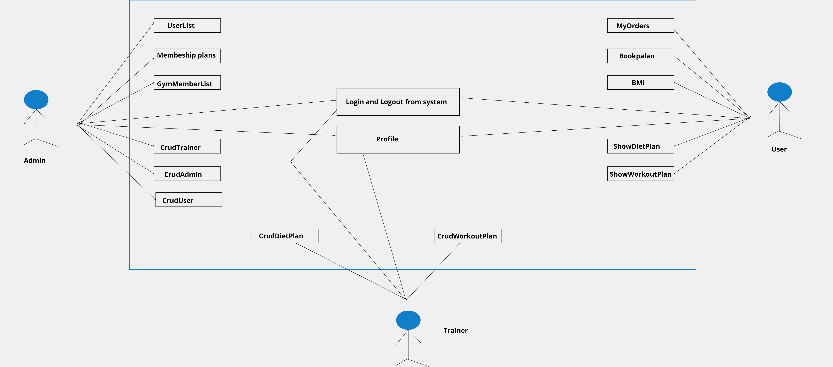
Case Diagram

Slide 8
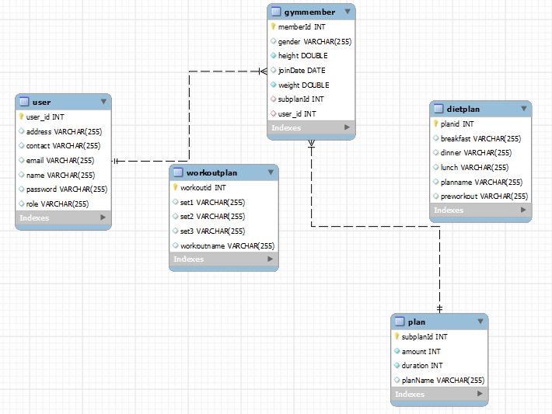
ER Diagram

Slide 9
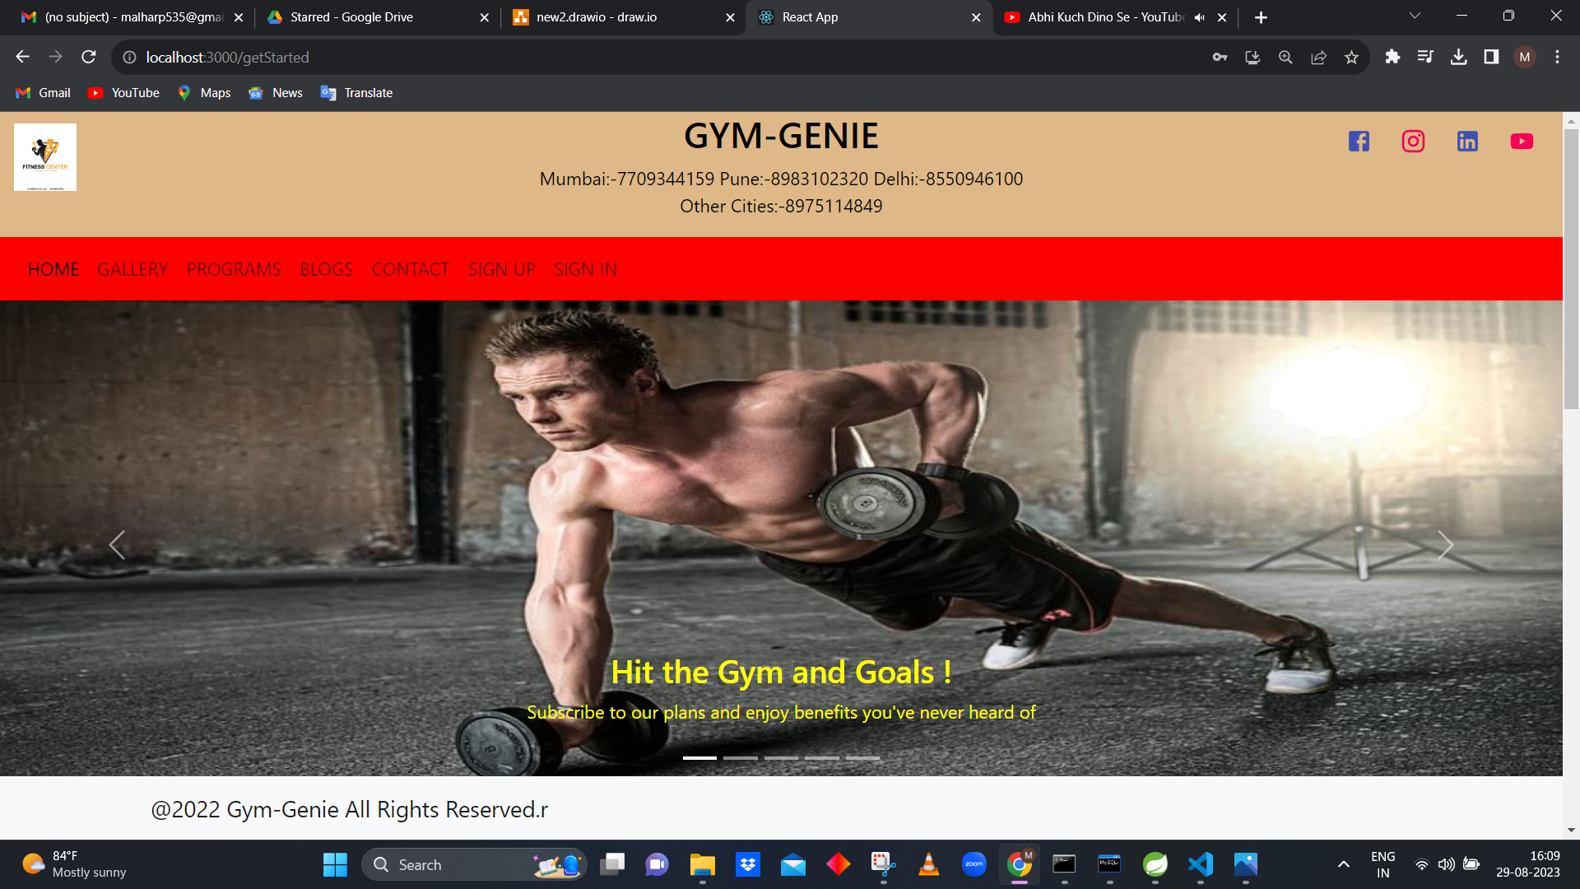
UI

Slide 10

UI

Slide 11
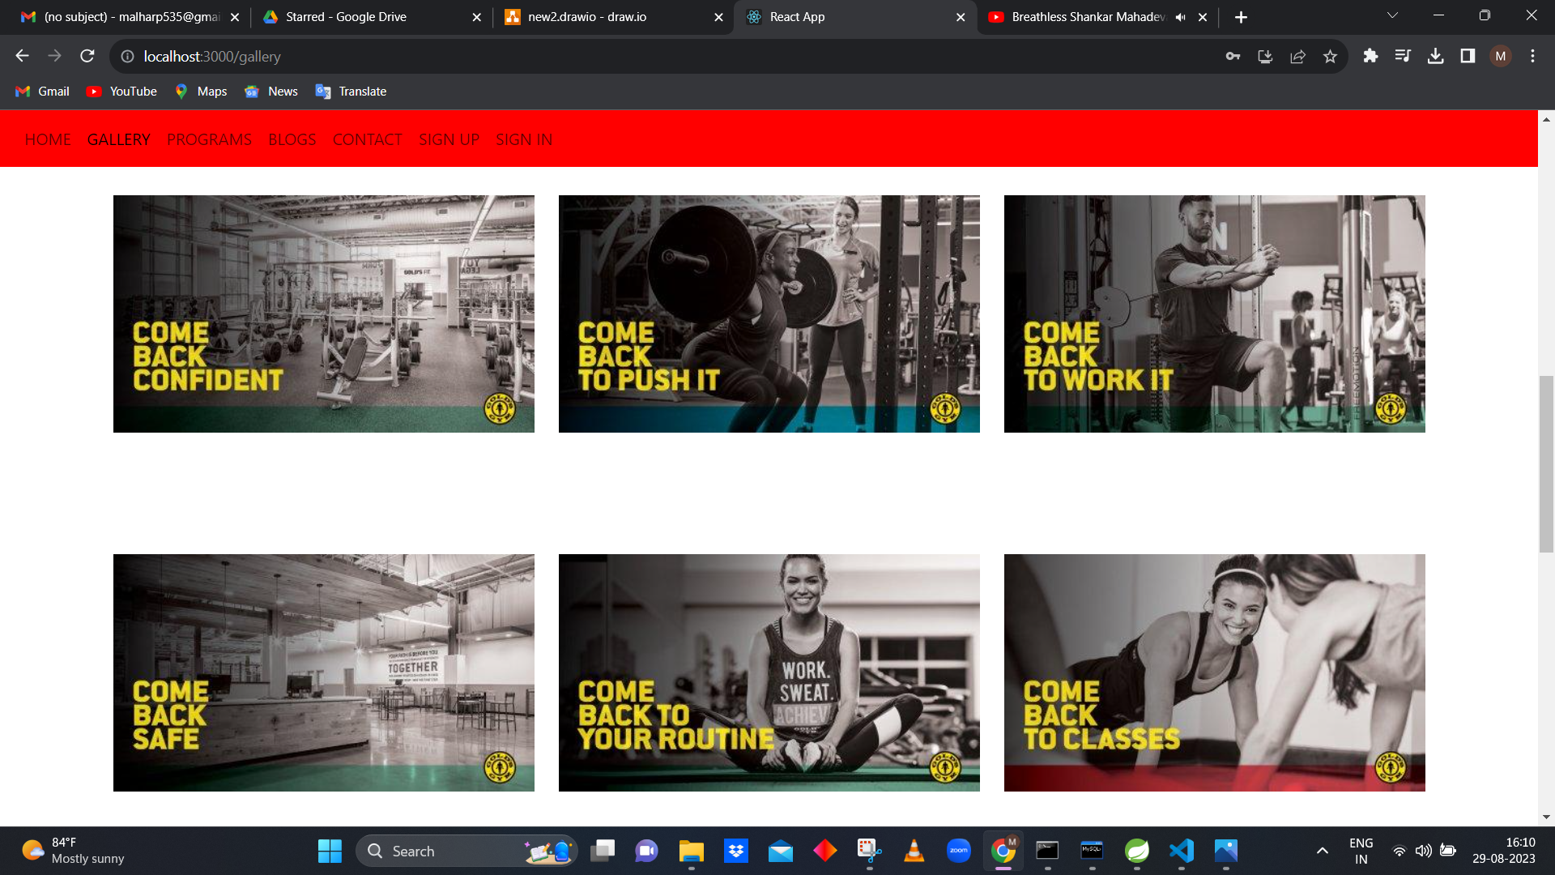
UI

Slide 12
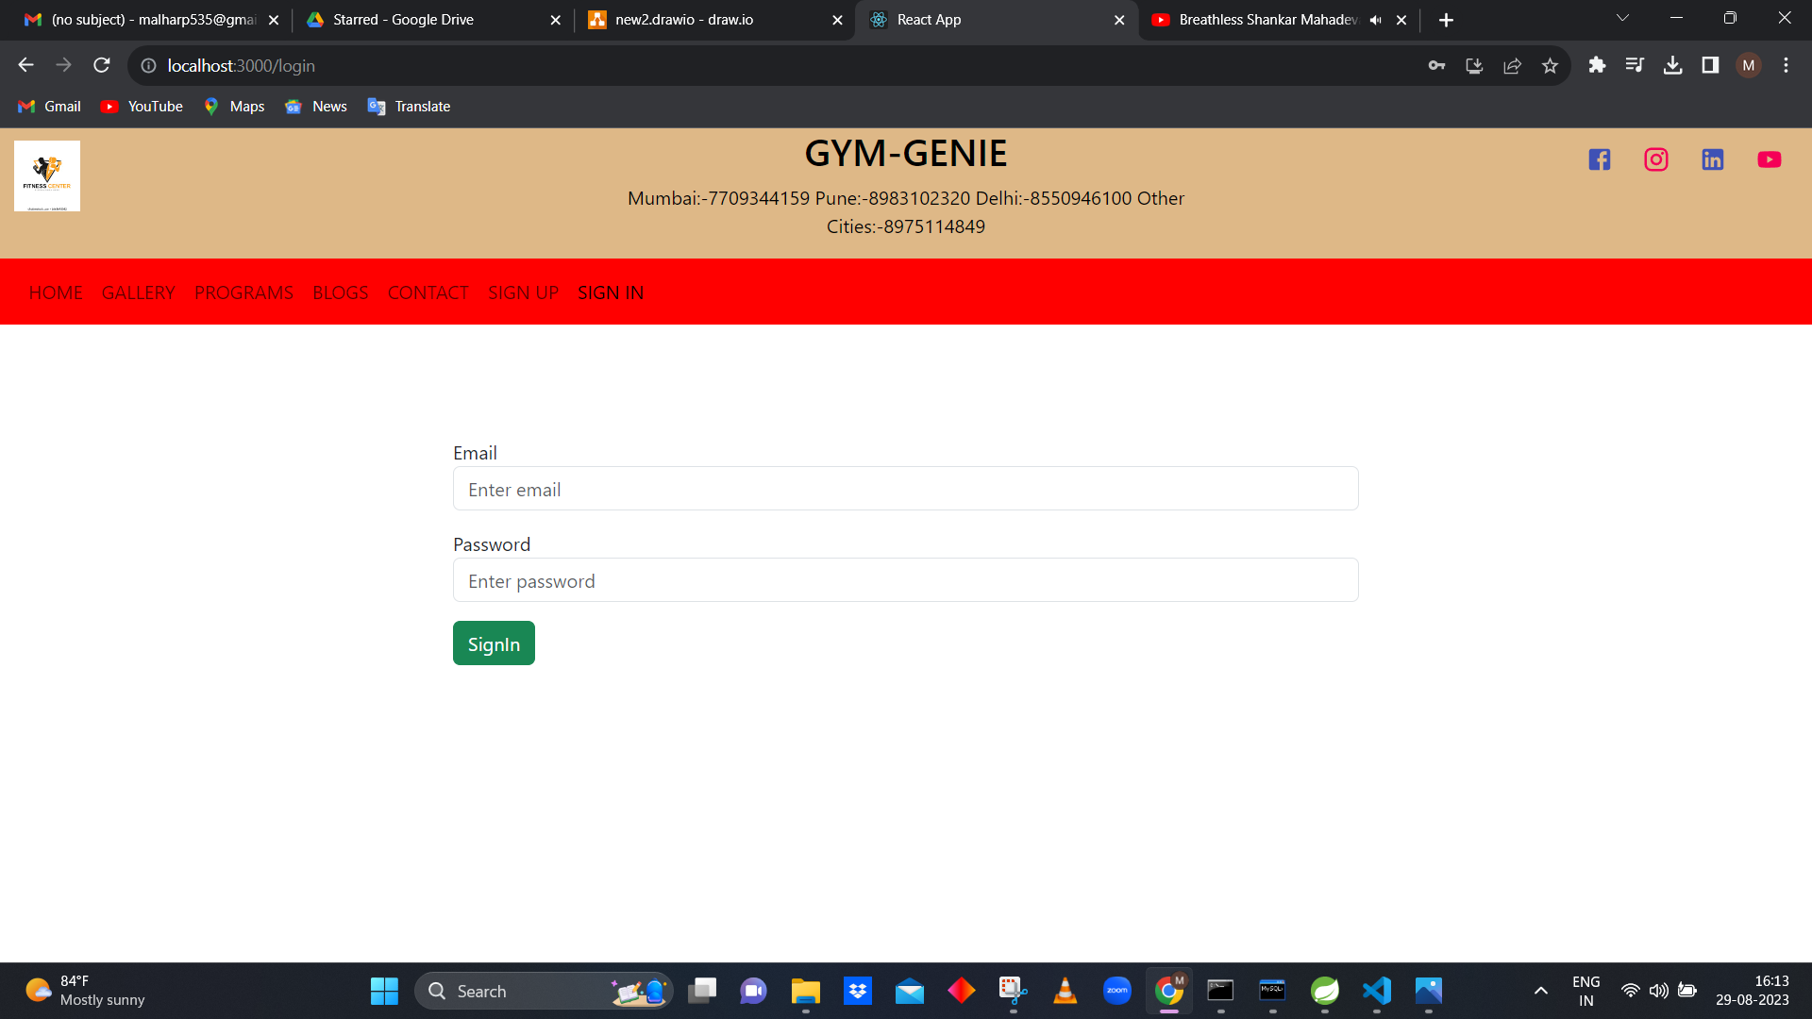
UI

Slide 13
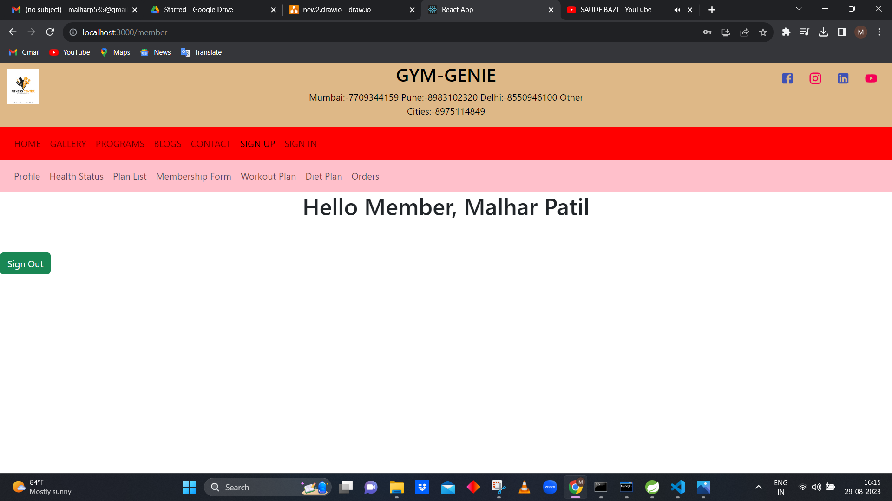
UI

Slide 14
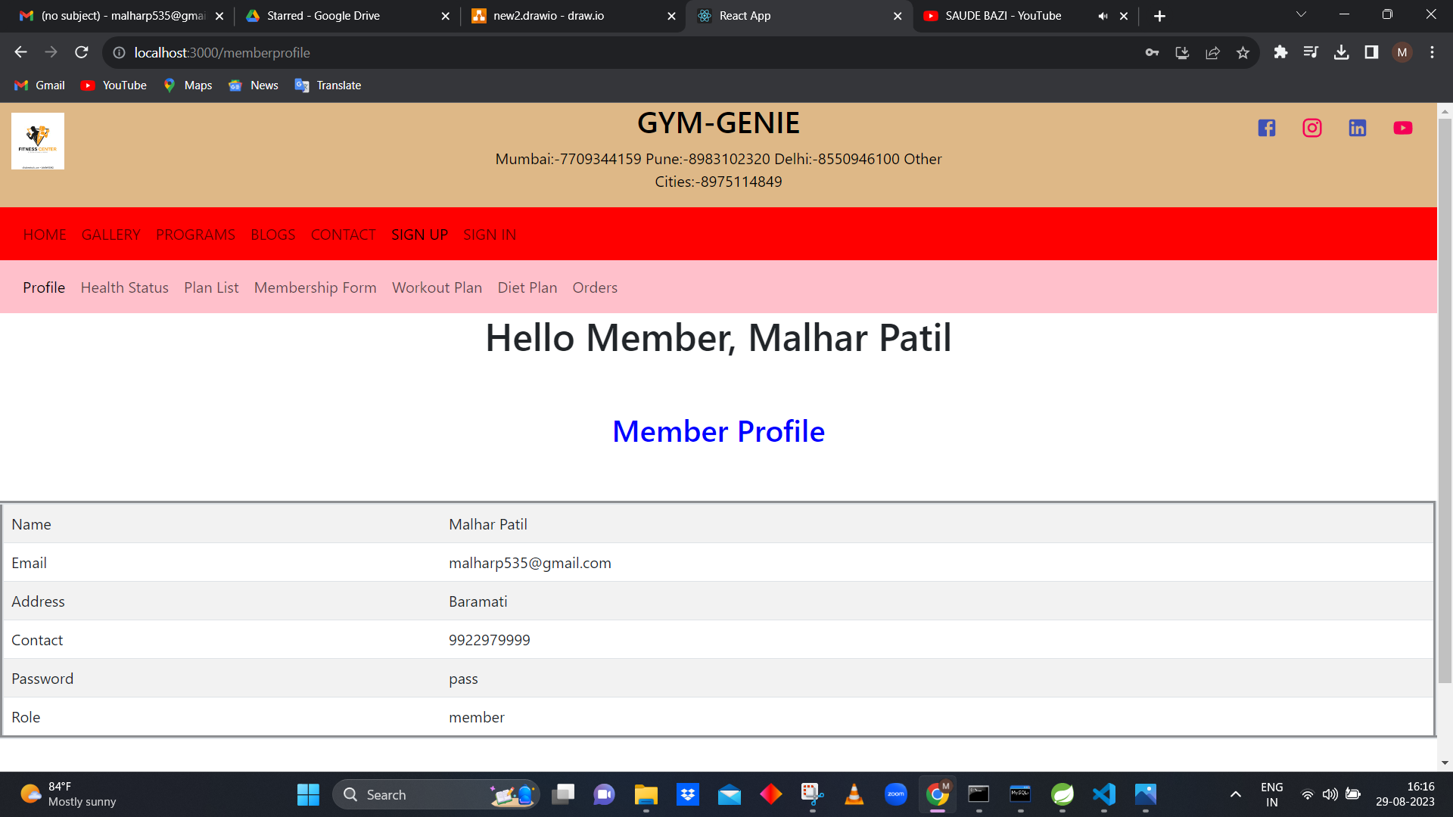
UI

Slide 15
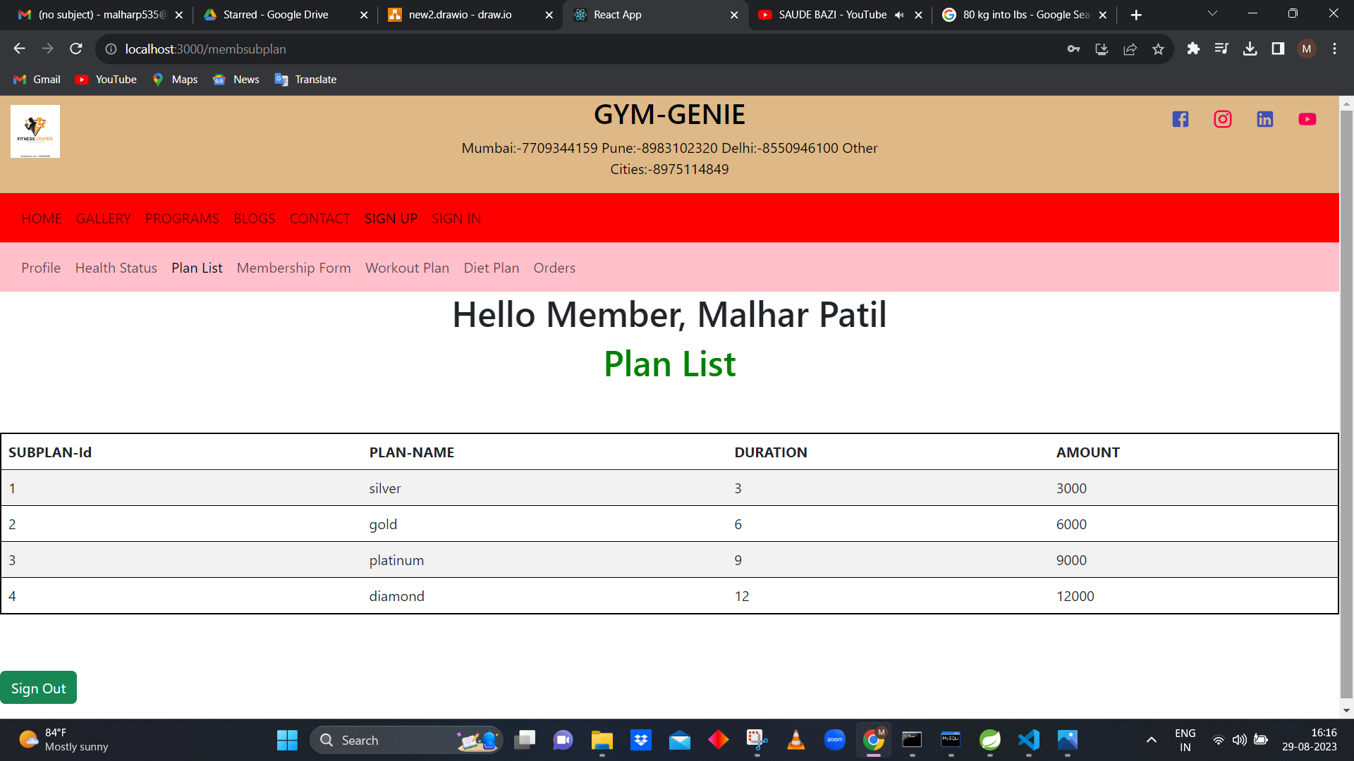
UI

